Slide 1
HT-Mold : Y’25 Chie-Tech / Automation summary
Summary status by Rank control
Rank | Activity | Plan Effective [ Month ] | Status [ items ] | Remark
D 0 - 25% (Design) | Purge material pressing machine No.3 Dot Auto Part Automation combine cell Auto load material 2nd inj. Unit Auto Print screen | Oct Oct Nov Nov Dec | 5
C 26 - 50% (Concept) | Auto Production Step.2 | Nov | 1
B 51% - 75% (Order) | Free Air compressor system Auto Drain Expand Auto Cut off Material Expand Box Check Temp. & Him. | Oct Sep Sep Sep | 4
A 76 - 100% (Making) | Material check Temp. sensor Jig check EP mold cassette Auto cut off material Jig Flip Part QC5-1906 Combine line 33J Auto Count Part Auto cut Gate FE2-L232 Sensor check Lock Daisha Purge material pressing machine No.2 Jig sticking film QC7-8139 Water Temp & Flow rate sensor No.2 Jig cutting POM Jig sticking film QC9-1762 TSS alarm status Machine | Feb Feb Mar Mar Apr May May May June June June => Aug Sep Jul Aug | 11/14
Slide
Slide Plan 2 Items.

Slide 2
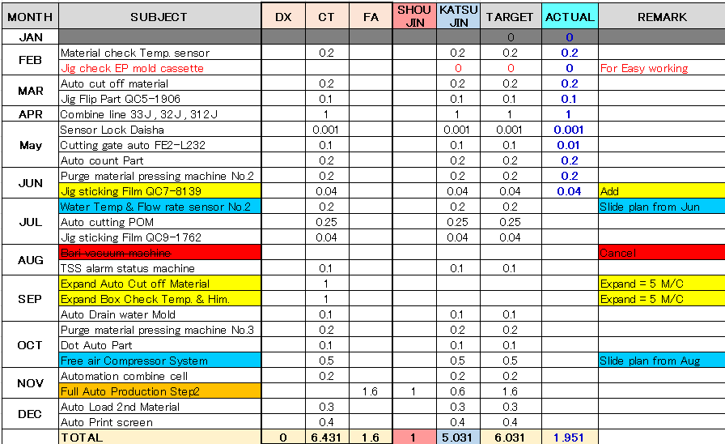
HT-Mold : Y’25 DX-Automation SUMMARY
2
[per]
Target 8.0 Per.
[item]
[item]
 | JAN | FEB | MAR | APR | MAY | JUN | JUL | AUG | SEP | OCT | NOV | DEC | TTL
TARGET | 0.00 | 0.20 | 0.30 | 1.00 | 0.30 | 0.24 | 0.49 | 0.10 | 0.10 | 0.80 | 1.90 | 0.60 | 6.03
ACTUAL | 0.00 | 0.20 | 0.30 | 0.1 | 0.21 | 0.24 | 0.2 | 0.00 | 0.00 | 0.00 | 0.00 | 0.00 | 1.95

Slide 3
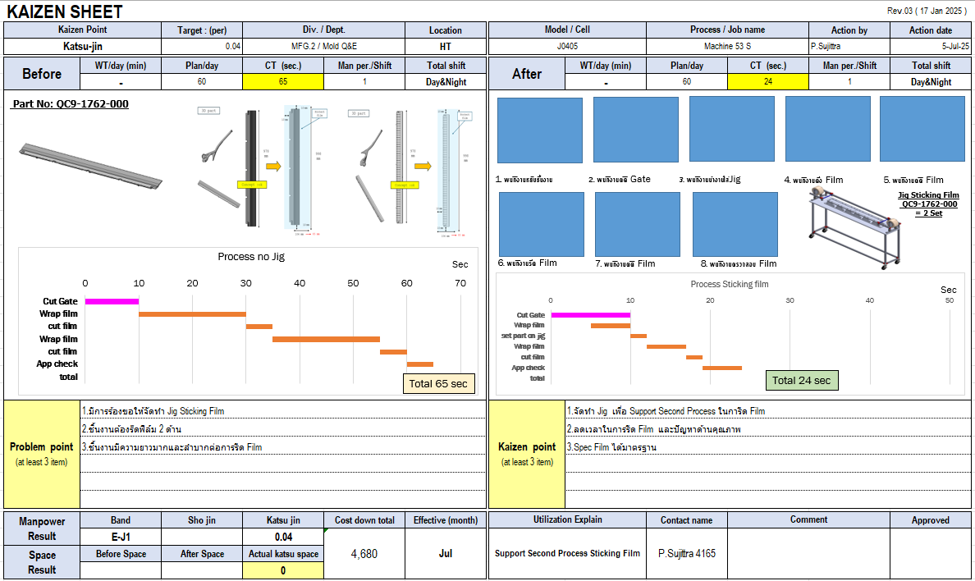
HT-MFG2 Y2025 DX-Automation : Example Chie-tech , Automation
3

Slide 4
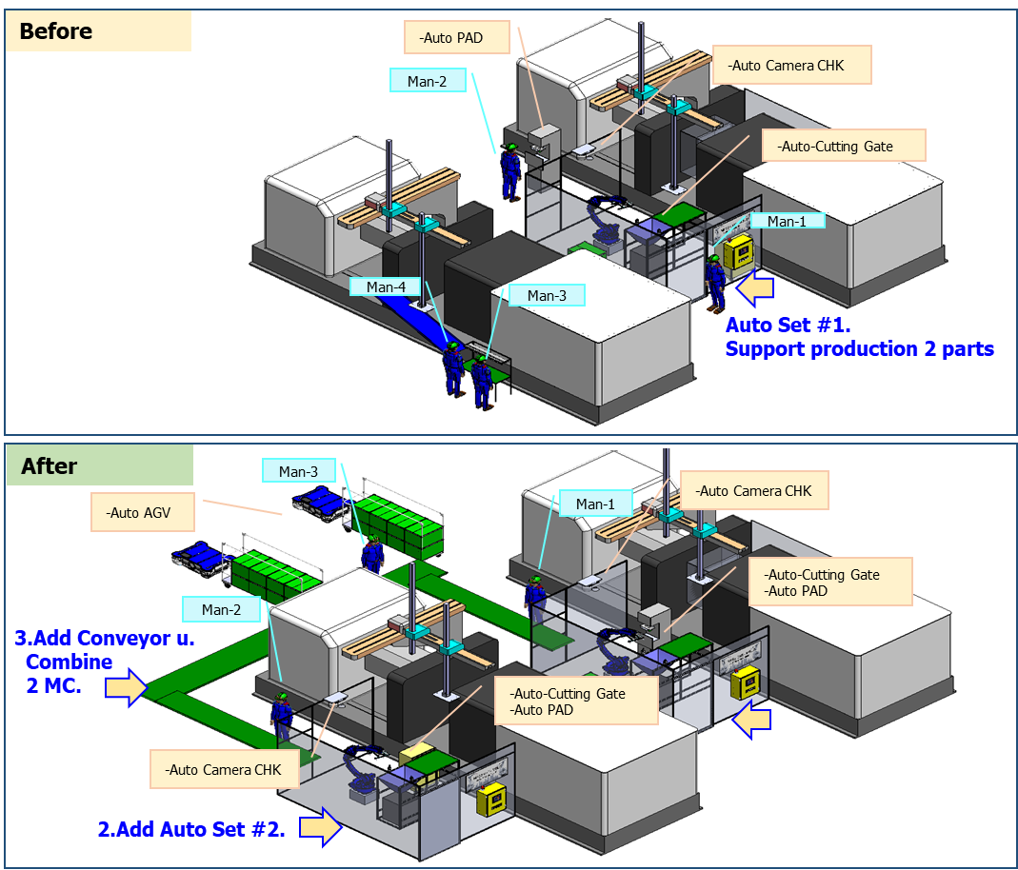
HT-MFG2 Y2025 DX-Automation : Example Chie-tech , Automation
4
HT-MOLD Full Automation 1000 Ton
■ Katsu-Jin , Sho-Jin
Process |  | Manpower (Person / Shift)
 |  | Before |  | After
 |  | 1001T | 1002T | 1001T | 1002T
1 | Cutting Gate | 1 | 1 | 0.7 Katsu-JIN =0.3 | 0.7 Katsu-JIN =0.3
2 | Cut Bari
3 | Cleaning Oil
4 | PAD Printing | 1 | 1
5 | Appearance Check |  |  | 1 (Sho-Jin = 1)
6 | Packing
Total |  | 4 |  | 2.4
Wait Production Confirm Time Man Power
Merit
Sho-JIN | 1 Pers.
Katsu-JIN | 0.6 Pers.
Start Plan | Nov’25
Action plan
 | Jul | Aug | Sep | Oct | Nov | Dec
Order
Making
Finish
Equipment Budget
Debug

Slide 5
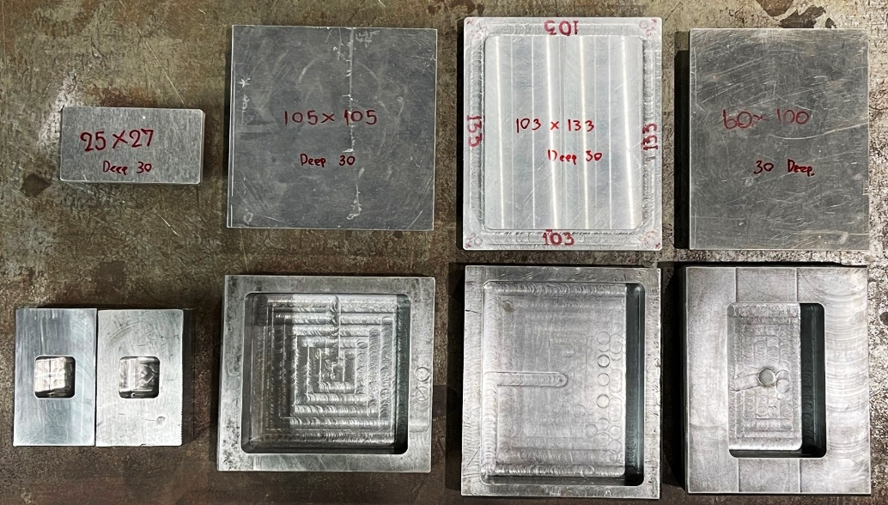
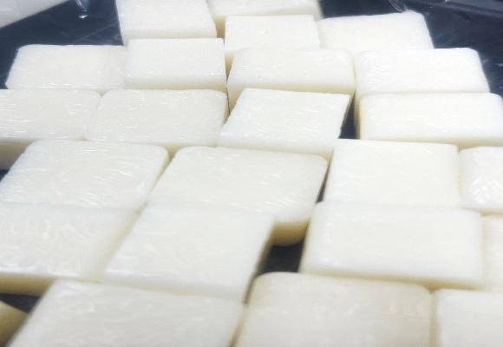
HT-MFG2 Y2025 DX-Automation : Example Chie-tech , Automation
5
Update Project Material POM
Box for Support Material POM Request Size = 4 Size
1
2
3
4
TDM Request Size 25 mm x 27mm x 30 mm
Send OK = 80 Pcs. = 2 Kg.
TDM Request Size 103 mm x 133 mm x 30 mm
= 20 Pcs. = 25 KG.
1.Size 25 mm x 27mm x 30 mm
2.Size 105 mm x 105 mm x 30 mm
3.Size 103 mm x 133 mm x 30 mm
4.Size 60 mm x 100 mm x 30 mm
PDE Request Size 105 mm x 105 mm x 30 mm
Send OK = 3 Pcs. = 1 KG.
Reuse Material = 28 KG.

Slide 6
APPENDIX

Slide 7
Expand project | Katsu jin | Jul | Aug | Sep | Oct | Nov | Dec
Cut off material | Item | 7 | 7 | 7 | 7 | 7 | 8
 | 0.2 | 1.4 | 1.4 | 1.4 | 1.4 | 1.4 | 1.6
Check Temp. & Humidity | Item | 7 | 7 | 7 | 7 | 7 | 8
 | 0.2 | 1.4 | 1.4 | 1.4 | 1.4 | 1.4 | 1.6
 | Total | 2.8 | 2.8 | 2.8 | 2.8 | 2.8 | 3.2
 |  |  |  |  | Total Katsu-Jin |  | 17.2
[per]
Target 8.0 Per.

Slide 8
